Slide 1
Natural Philosophy - The Bridge Between Science and Theology
Using Aristotle’s Four Causes as the foundation for discussion

Slide 2
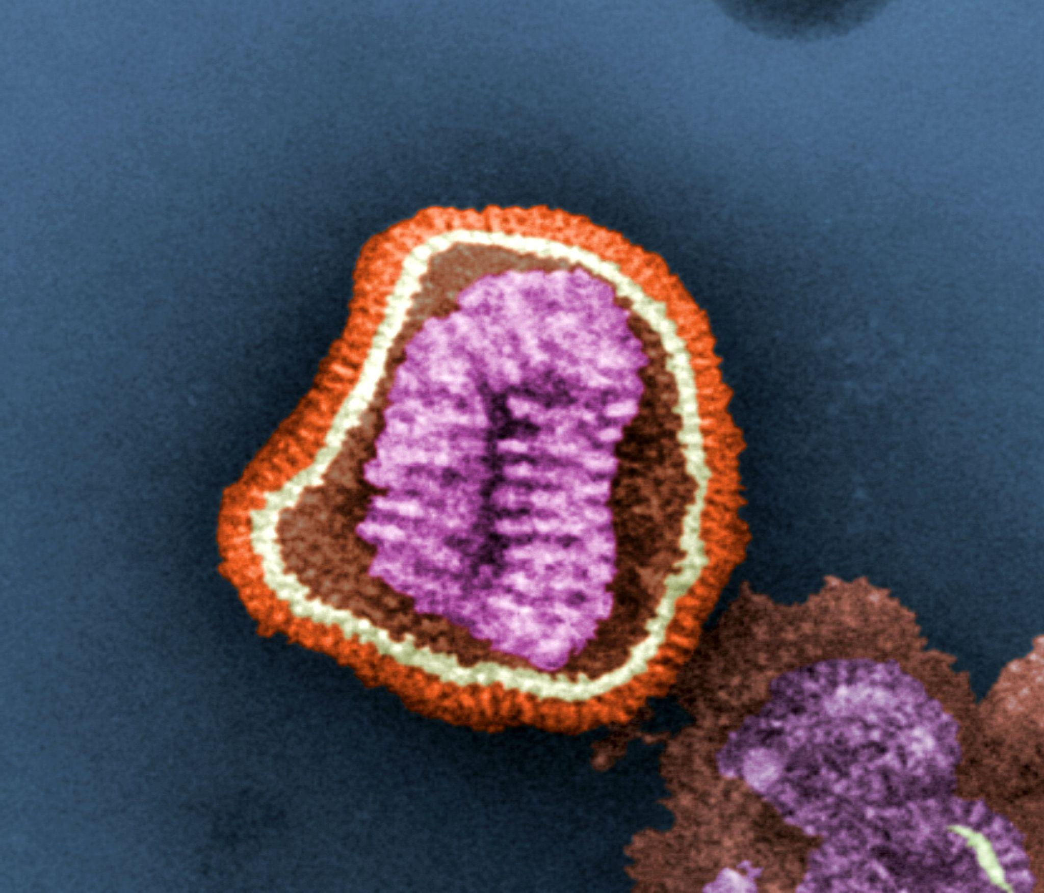
See/Think/Wonder

Slide 3
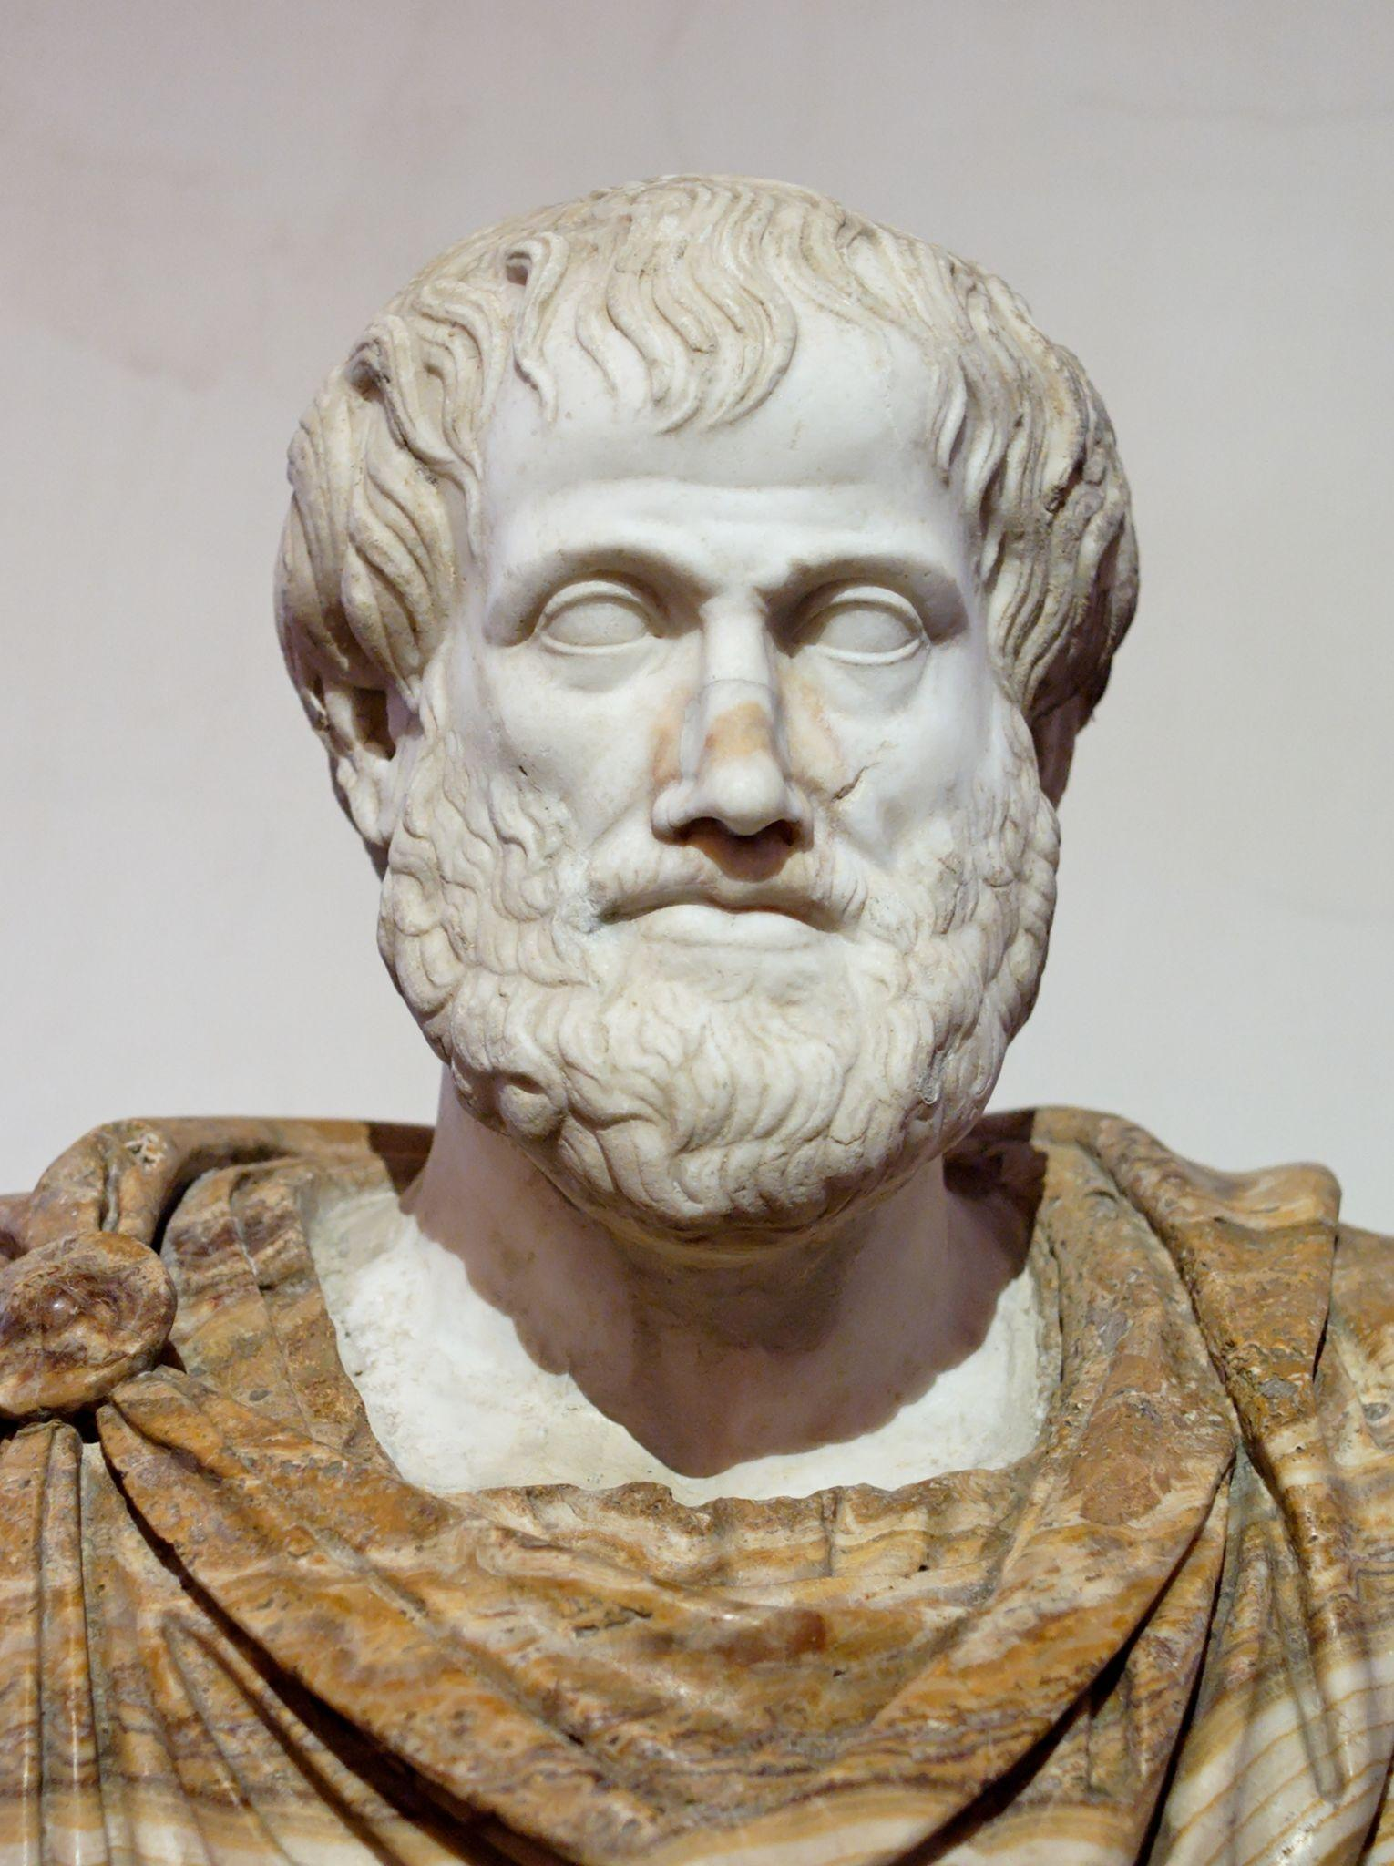
See/Think/Wonder
I see…
I think…
I wonder…

Slide 4
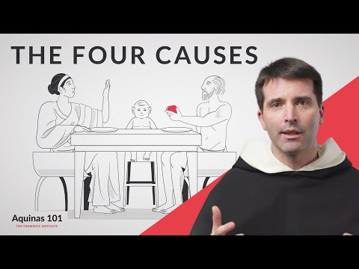
The Four Causes (Aquinas 101)

Slide 5
Aristotle and Natural Philosophy?
Look at what makes a thing a thing, Aristotle’s Four Causes.
Material - what the object is made of
Efficient - the agent or "force" that is responsible for the existence of the object
Formal - the form, essence, or nature that explains how the object exists
Final -the purpose or end for which the object exists
Notes:
It might be good to ask the question: “How do these four causes relate to one another?” This would help the students see the intrinsic relationship between them and understand how they are complementary rather than disconnected or contradictory.

Slide 6
Exit Ticket
Based on what we discussed, answer the following question:
How can we use this philosophical belief to help describe (classify) the reason why objects are able to be different? Give at least one example to support your thought.

Slide 7
Using the Four Causes - Walkthrough
Material
Efficient
Object
Formal
Final

Slide 8
Expanding the concepts - Activator
“Is water wet”?
Can you use the 4 causes to describe/classify the object (water)?
What about something more complex - like a tree?
What other examples can you consider?
Determine at least one and discuss it with your partner
Report out your findings

Slide 9
Expanding the concepts - Exit Ticket
What other examples can you consider?
Determine at least one and discuss it with your partner
Report out your findings

Slide 10
Activator
What is Chemistry?
What makes chemistry a distinct science relative to physics or biology?
Why do you think it might be important to take this class?

Slide 11
Research Then Report Out
What is the historical foundation of chemistry?

Slide 12
Chemistry as a science
What do we ‘study’ in chemistry?
How does this relate to Natural Philosophy?
How does this relate to the four causes?
Does it easily relate to all four?
Why or why not?

Slide 13
Activator
If we classify the atom as an aspect of the material “cause”, then how does the atom lend itself to the remaining causes?

Slide 14
Question????
Science allows us to understand the physical world, chemistry specifically allows us to understand the chemical interactions of the world,
but it does not allow us to understand the why.
So which discipline allows us to continue this discussion?

Slide 15
Socratic Discussion
What are the natural laws?
How do we know they exist?
Why do they exist?
If they exist and we can use science to measure/test/observe them does that explain why they exist?
So then why do we study science?
Why should we study theology?

Slide 16
Measuring Matter
Explore cause and effect relationships in nature
Understanding of matter, how we measure matter.
How measurements allow us to describe matter.

